Slide 1

Markov Processes: Case Study
MTH 564 – Mathematical Modeling

Slide 2

Problem
A mechanic working for a heavy equipment repair facility is responsible for the repair and maintenance of forklift trucks. When forklifts break down, they are taken to the repair facility and serviced in the order of their arrival. There is space for 27 forklift trucks at the facility, and last year the facility repaired 54 trucks. Average repair time for a single vehicle is about three days. In the past few months certain questions have been raised about the effectiveness and efficiency of this operation. The two central issues are the time it takes to have a machine repaired, and the percentage of time the mechanic devotes to this part of his duties.

Slide 3
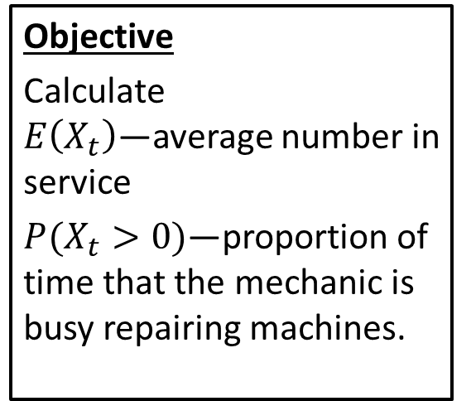
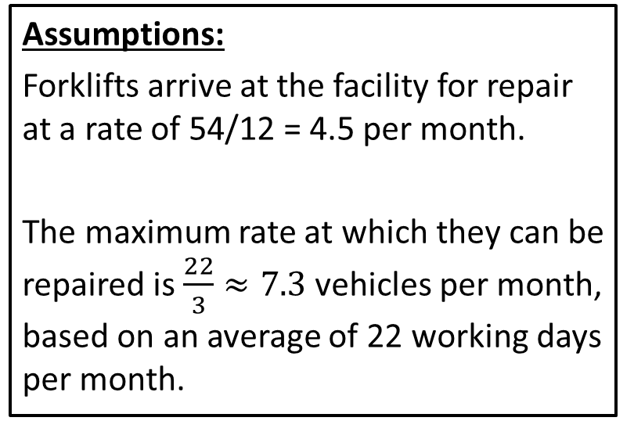
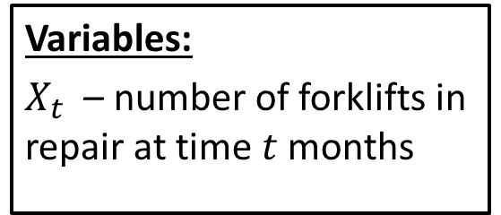
Step 1: Frame the problem
Variables:
$X_{t}$ – number of forklifts in repair at time $t$ months
Assumptions:
Forklifts arrive at the facility for repair at a rate of 54/12 = 4.5 per month.
The maximum rate at which they can be repaired is $\frac{22}{3}≈7.3$ vehicles per month, based on an average of 22 working days per month.
Objective
Calculate $E\left(X_{t}\right)$—average number in service
$P(X_{t}>0)$—proportion of time that the mechanic is busy repairing machines.

Slide 4
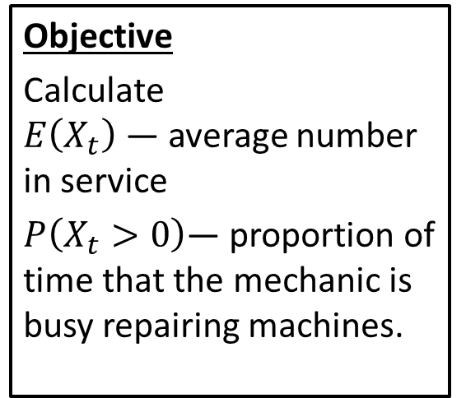
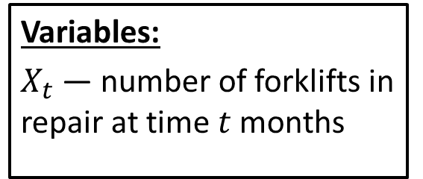
Step 2: Select the modeling approach
Variables:
$X_{t}$— number of forklifts in repair at time $t$ months
Assumptions:
Forklifts arrive at the facility for repair at a rate of 54/12 = 4.5 per month.
The maximum rate at which they can be repaired is $\frac{22}{3}≈7.3$ vehicles per month, based on an average of 22 working days per month.
Objective
Calculate $E\left(X_{t}\right)$— average number in service
$P\left(X_{t}>0\right)$— proportion of time that the mechanic is busy repairing machines.
Modeling Approach
We model the repair facility using a Markov process.

Slide 5
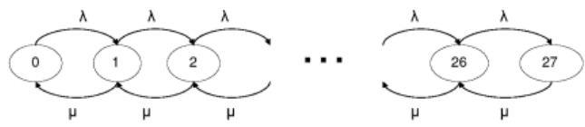
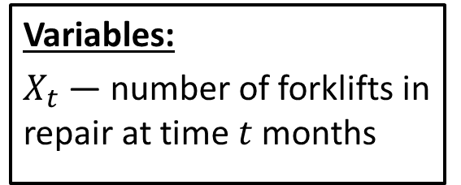
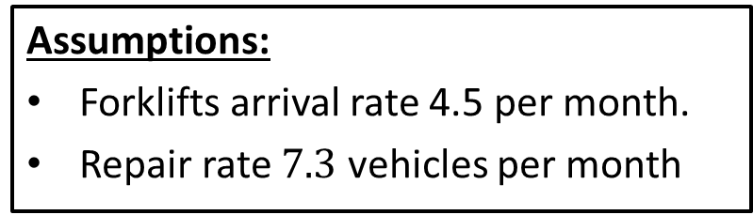
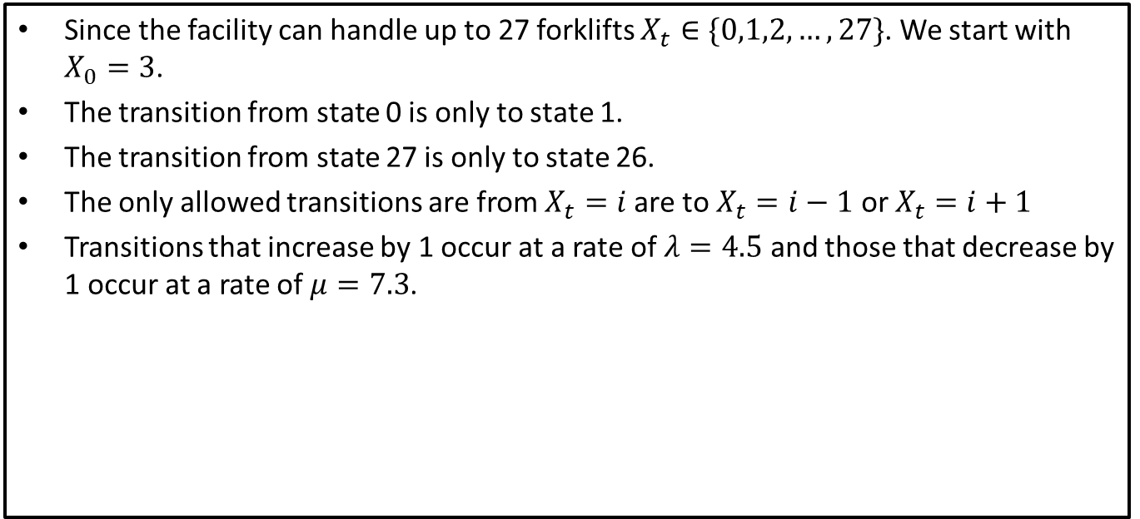
Step 3: Formulate the model
Assumptions:
Forklifts arrival rate 4.5 per month.
Repair rate $7.3$ vehicles per month
Variables:
$X_{t}$— number of forklifts in repair at time $t$ months
Since the facility can handle up to 27 forklifts $X_{t}∈\{0,1,2,…,27\}$. We start with $X_{0}=3$.
The transition from state 0 is only to state 1.
The transition from state 27 is only to state 26.
The only allowed transitions are from $X_{t}=i$ are to $X_{t}=i−1$ or $X_{t}=i+1$
Transitions that increase by 1 occur at a rate of $λ=4.5$ and those that decrease by 1 occur at a rate of $μ=7.3$.

Slide 6
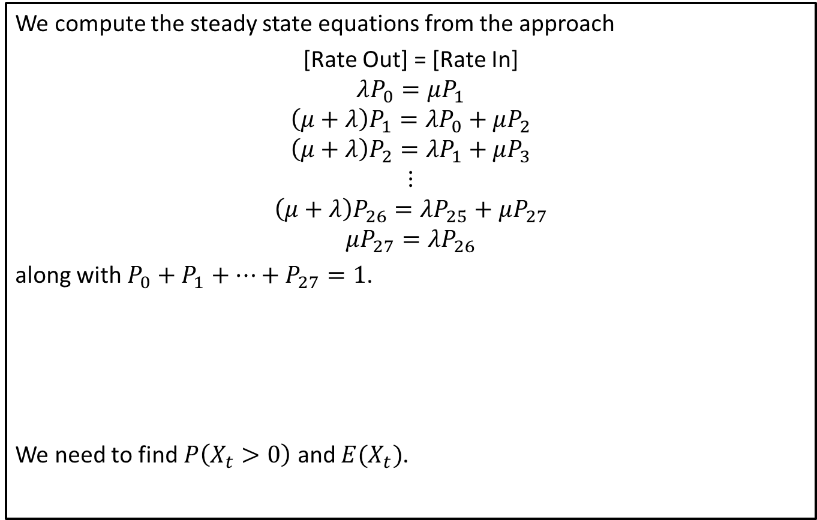
Step 3: Formulate the model
We compute the steady state equations from the approach
[Rate Out] = [Rate In]
$$λP_{0}=μP_{1}$$
$$\left(μ+λ\right)P_{1}=λP_{0}+μP_{2}$$
$$\left(μ+λ\right)P_{2}=λP_{1}+μP_{3}$$
$$⋮$$
$$\left(μ+λ\right)P_{26}=λP_{25}+μP_{27}$$
$$μP_{27}=λP_{26}$$
along with $P_{0}+P_{1}+⋯+P_{27}=1$.
We need to find $P\left(X_{t}>0\right)$ and $E(X_{t})$.

Slide 7
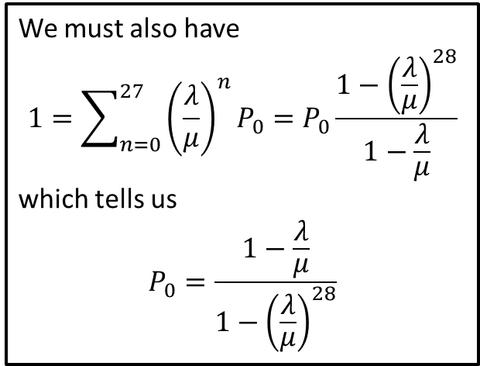
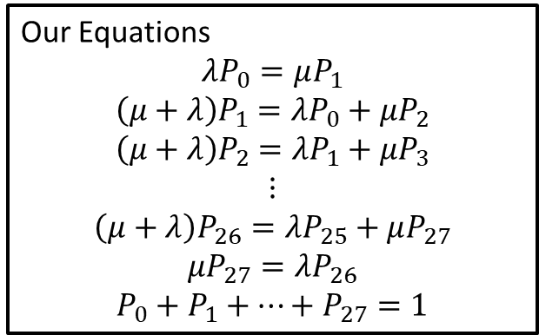
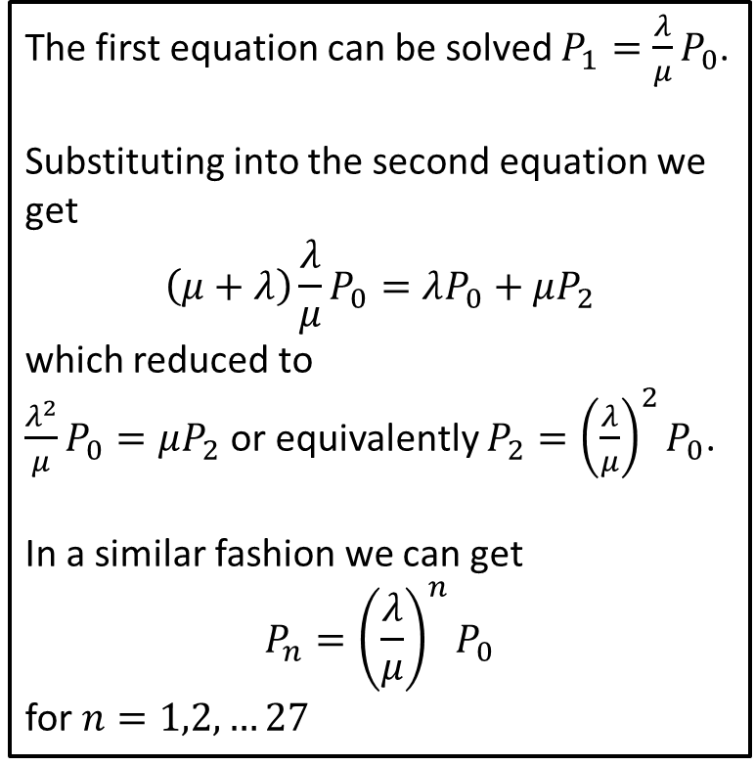
Step 4: Solve the Problem
Our Equations
$$λP_{0}=μP_{1}$$
$$\left(μ+λ\right)P_{1}=λP_{0}+μP_{2}$$
$$\left(μ+λ\right)P_{2}=λP_{1}+μP_{3}$$
$$⋮$$
$$\left(μ+λ\right)P_{26}=λP_{25}+μP_{27}$$
$$μP_{27}=λP_{26}$$
$$P_{0}+P_{1}+⋯+P_{27}=1$$
The first equation can be solved $P_{1}=\frac{λ}{μ}P_{0}$.
Substituting into the second equation we get $$\left(μ+λ\right)\frac{λ}{μ}P_{0}=λP_{0}+μP_{2}$$ which reduced to $\frac{λ^{2}}{μ}P_{0}=μP_{2}$ or equivalently $P_{2}={\left(\frac{λ}{μ}\right)}^{2}P_{0}$.
In a similar fashion we can get $$P_{n}={\left(\frac{λ}{μ}\right)}^{n}P_{0}$$ for $n=1,2, …27$
We must also have
$$1=\sum_{n=0}^{27}{{\left(\frac{λ}{μ}\right)}^{n}P_{0}=P_{0}\frac{1−{\left(\frac{λ}{μ}\right)}^{28}}{1−\frac{λ}{μ}}}$$
which tells us
$$P_{0}=\frac{1−\frac{λ}{μ}}{1−{\left(\frac{λ}{μ}\right)}^{28}}$$
Notes:
See python file section1-1pig.py

Slide 8
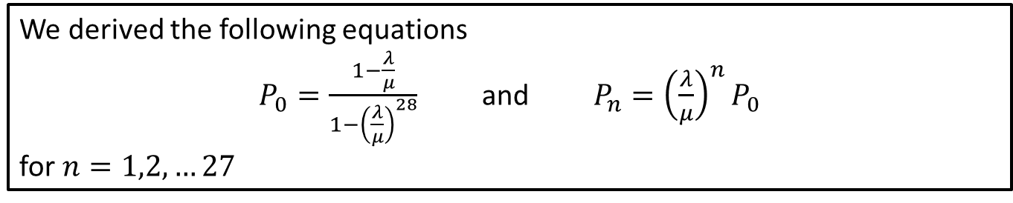
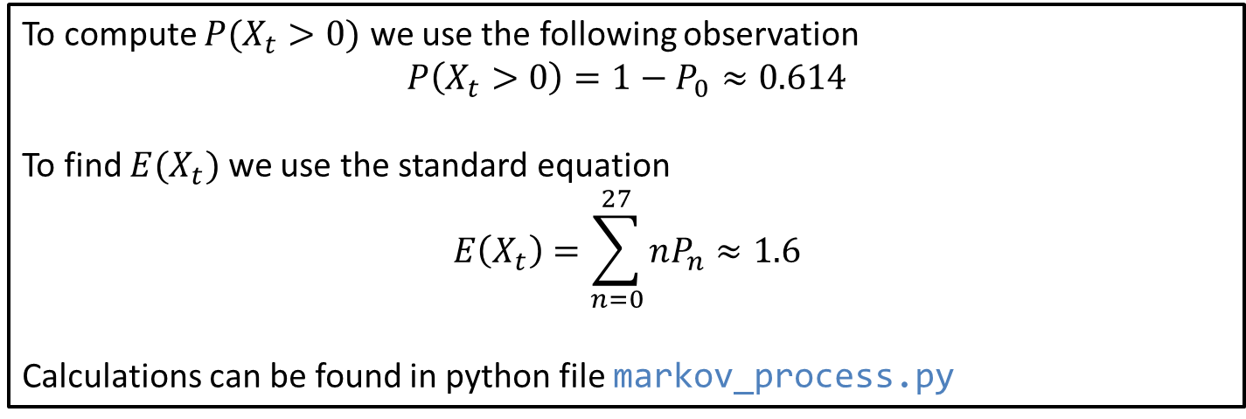
Step 4: Solve the Problem
We derived the following equations
$P_{0}=\frac{1−\frac{λ}{μ}}{1−{\left(\frac{λ}{μ}\right)}^{28}}$ and $P_{n}={\left(\frac{λ}{μ}\right)}^{n}P_{0}$
for $n=1,2, …27$
To compute $P(X_{t}>0)$ we use the following observation
$$P\left(X_{t}>0\right)=1−P_{0}≈0.614$$
To find $E(X_{t})$ we use the standard equation
$$E\left(X_{t}\right)=\sum_{n=0}^{27}{nP_{n}}≈1.6$$
Calculations can be found in python file markov_process.py
Notes:
See python file section1-1pig.py

Slide 9
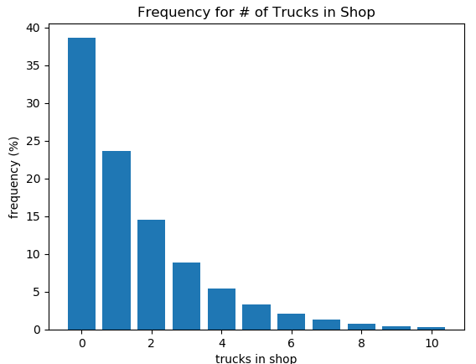
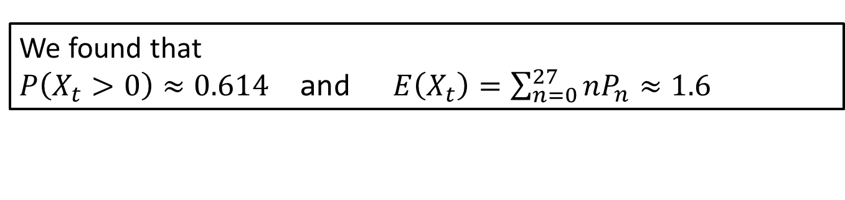
Step 5: Answer the question
We found that
$P\left(X_{t}>0\right)≈0.614$ and $E\left(X_{t}\right)=\sum_{n=0}^{27}{nP_{n}}≈1.6$
Since the rate at which vehicles arrive for repair is only about 60% of the potential service, the mechanic is busy with this activity only about 60% of the time.
However, breakdowns occur at random. So there will be times when there is more than one vehicle in the shop at one time. In fact, on an average day we would expect to see 1.6 vehicles in the repair facility.
The distribution we expect can be found in this figure.
Notes:
See python file section1-1pig.py

Slide 10
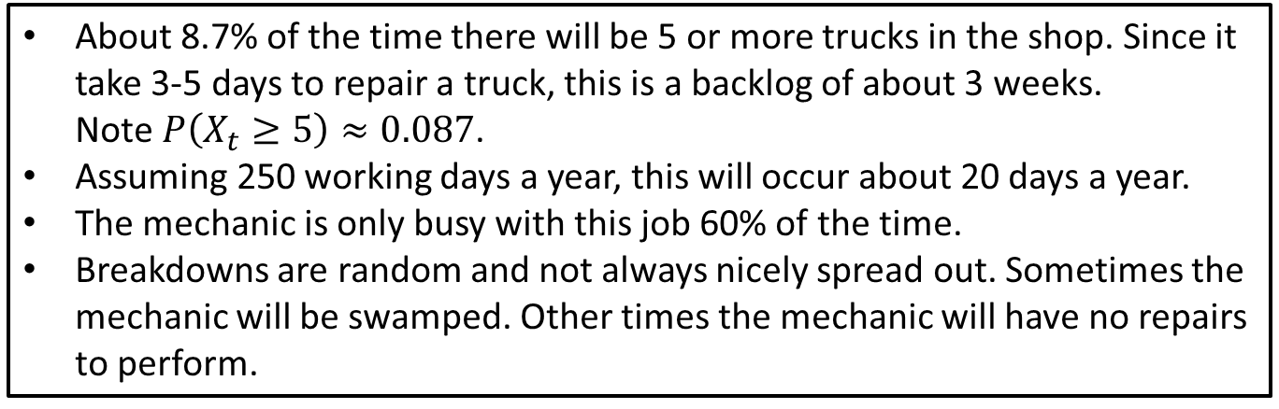
Step 5: Other Observations
About 8.7% of the time there will be 5 or more trucks in the shop. Since it take 3-5 days to repair a truck, this is a backlog of about 3 weeks. Note $P\left(X_{t}≥5\right)≈0.087$.
Assuming 250 working days a year, this will occur about 20 days a year.
The mechanic is only busy with this job 60% of the time.
Breakdowns are random and not always nicely spread out. Sometimes the mechanic will be swamped. Other times the mechanic will have no repairs to perform.
Management Issues
The problem of idle time for the mechanic.
No way to avoid the sporadic nature of this job activity
Consider if the mechanic can perform other duties during idle time (duties that can be interrupted)
The problem of backlogs (forklifts waiting to be repaired).
Additional study may be required to determine if more manpower should be devoted to this activity in these situations.
Notes:
See python file section1-1pig.py

Slide 11
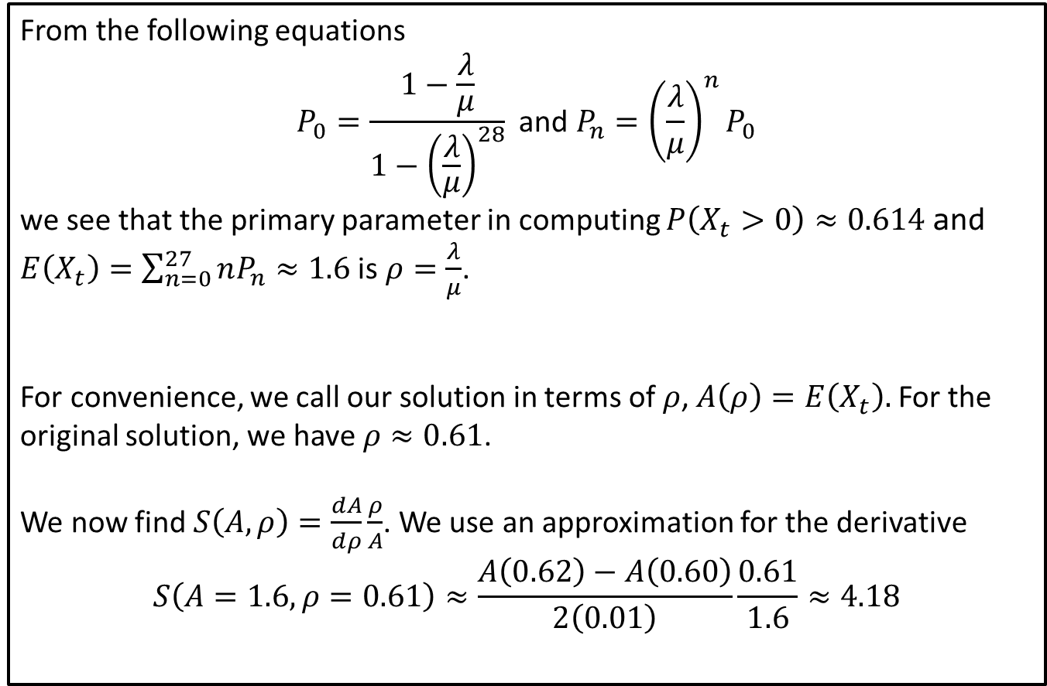
Sensitivity Analysis: Mean
From the following equations
$$P_{0}=\frac{1−\frac{λ}{μ}}{1−{\left(\frac{λ}{μ}\right)}^{28}} \text{and} P_{n}={\left(\frac{λ}{μ}\right)}^{n}P_{0}$$
we see that the primary parameter in computing $P\left(X_{t}>0\right)≈0.614$ and $E\left(X_{t}\right)=\sum_{n=0}^{27}{nP_{n}}≈1.6$ is $ρ=\frac{λ}{μ}$.
For convenience, we call our solution in terms of $ρ$, $A\left(ρ\right)=E\left(X_{t}\right).$ For the original solution, we have $ρ≈0.61$.
We now find $S\left(A, ρ\right)=\frac{dA}{dρ}\frac{ρ}{A}$. We use an approximation for the derivative
$$S\left(A=1.6,ρ=0.61\right)≈\frac{A\left(0.62\right)−A\left(0.60\right)}{2\left(0.01\right)}\frac{0.61}{1.6}≈4.18$$
Notes:
See python file section1-1pig.py

Slide 12
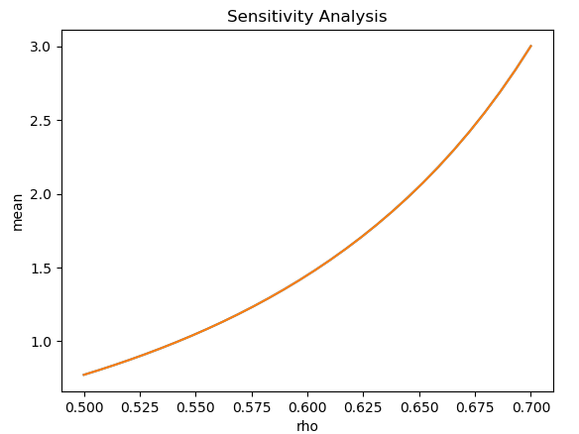
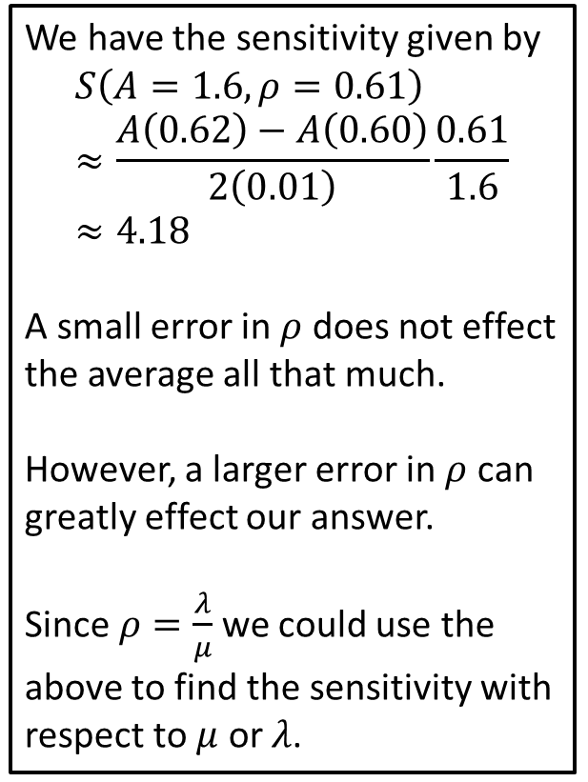
Sensitivity Analysis: Mean
We have the sensitivity given by
$$S\left(A=1.6,ρ=0.61\right)≈\frac{A\left(0.62\right)−A\left(0.60\right)}{2\left(0.01\right)}\frac{0.61}{1.6}≈4.18$$
A small error in $ρ$ does not effect the average all that much.
However, a larger error in $ρ$ can greatly effect our answer.
Since $ρ=\frac{λ}{μ}$we could use the above to find the sensitivity with respect to $μ$ or $λ$.
Notes:
See python file section1-1pig.py

Slide 13
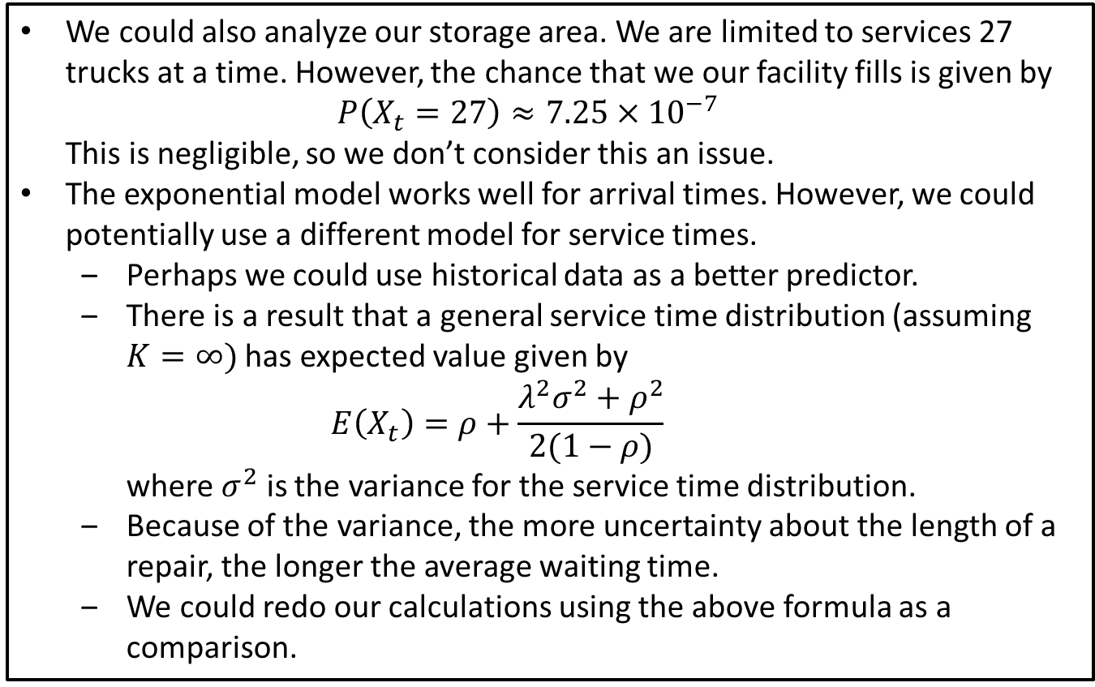
Sensitivity and Robustness
We could also analyze our storage area. We are limited to services 27 trucks at a time. However, the chance that we our facility fills is given by $P\left(X_{t}=27\right)≈7.25×{10}^{−7}$ This is negligible, so we don’t consider this an issue.
The exponential model works well for arrival times. However, we could potentially use a different model for service times.
Perhaps we could use historical data as a better predictor.
There is a result that a general service time distribution (assuming $K=∞)$ has expected value given by $E\left(X_{t}\right)=ρ+\frac{λ^{2}σ^{2}+ρ^{2}}{2(1−ρ)}$ where $σ^{2}$ is the variance for the service time distribution.
Because of the variance, the more uncertainty about the length of a repair, the longer the average waiting time.
We could redo our calculations using the above formula as a comparison.

